Slide 1
Visualization

Slide 2
Agenda
Why Visualizations
Tools for Visualization
D3

Slide 3
What do Visualizations do?
Understanding -> Easy / Convincing
-> Problem Solving
Relationships – Trends of data

Slide 4
What do Visualizations do?
Describe and communicate a message
Discover unknown relationships and characteristics of the data

Slide 5
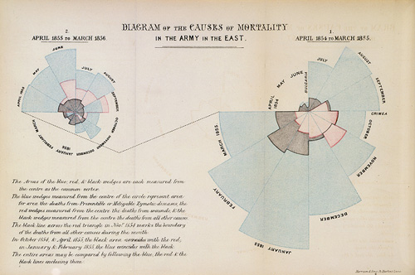

Slide 6
Alternate Representations
http://understandinguncertainty.org/coxcomb s

Slide 7
What Dimensions are shown?

Slide 8
What Dimensions are shown
Number – Number of casualties
Cause of Death – What is the cause of death
Month – When did the issue occur?

Slide 9

Napoleon's March to Moscow

Slide 10
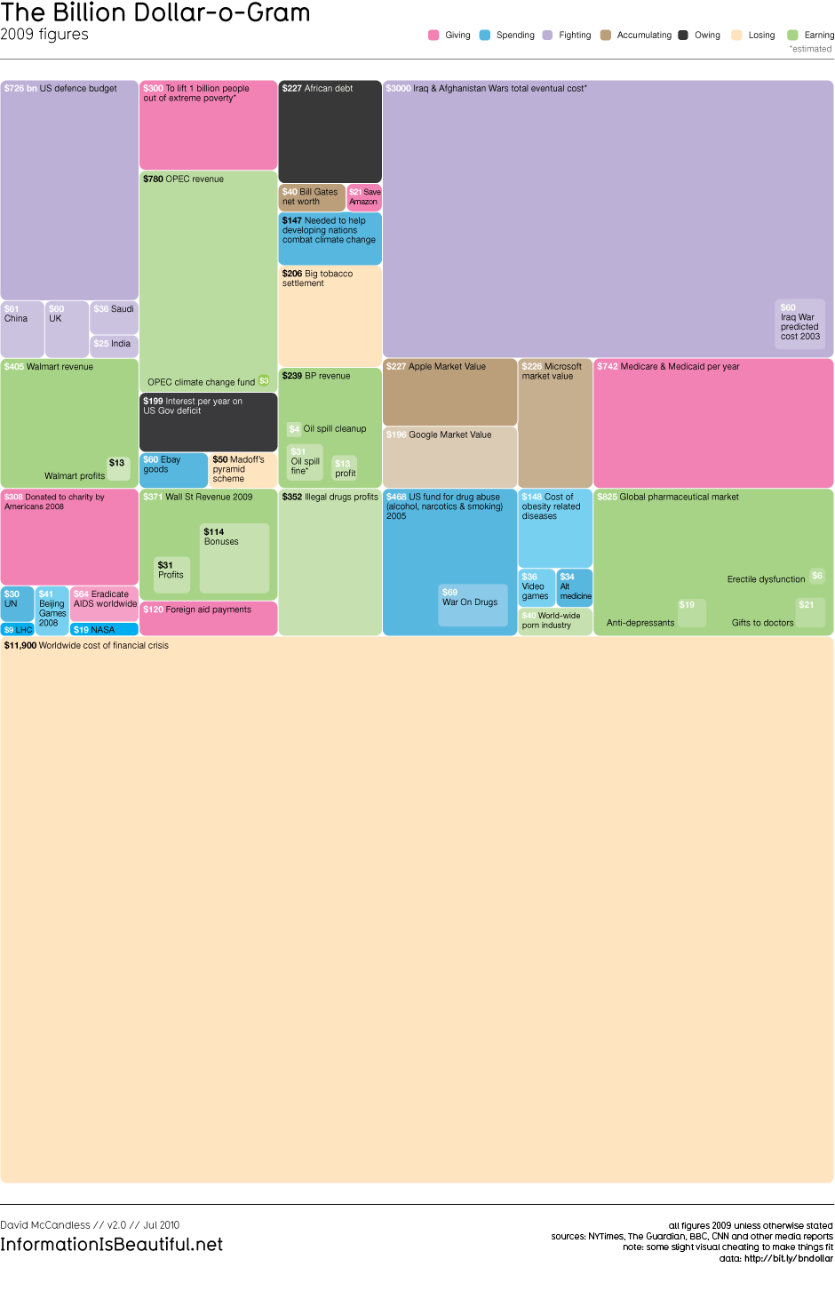

Slide 11
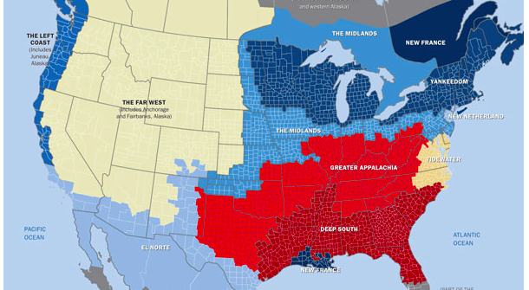
Differences in Country

Slide 12
LIVE WIND MAP
http://hint.fm/wind/

Slide 13
Food Consumption
http://www.foodservicewarehouse.com/calorie-viz/

Slide 14
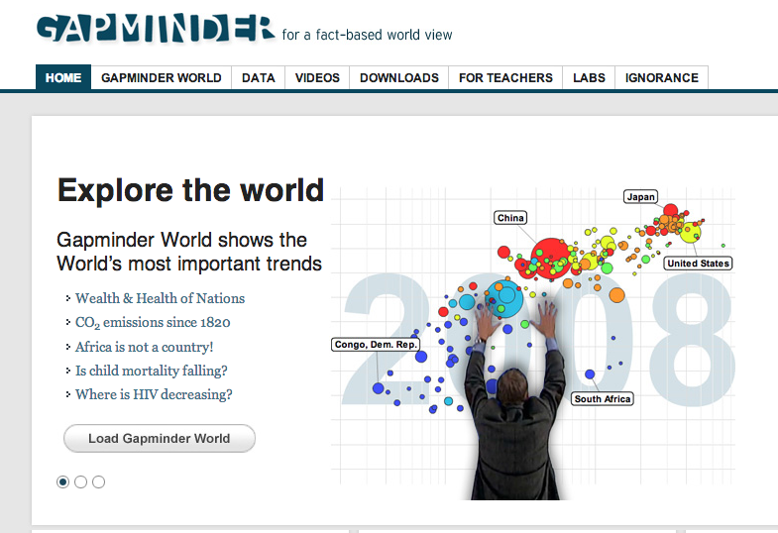
Gapminder
http://www.gapminder.org/
http://www.gapminder.org/videos/the-joy-of-stats/
Notes:
Watch between 26+

Slide 15
Where does visualization fit?
#Stages of Model Development
1. Data understanding
2. Data preparation
3. Modeling
4. Evaluation
5. Deployment (DDD)
5. Business Understanding

Slide 16
Steps
Visualization can be part of CRISP process
Data Understanding (Help in distributions)
Data Preparation
Modeling (Build Visual models)
Pick key features of interest
Iteratively add data layers that capture additional features
Data Understanding vs. Data Deployment

Slide 17
Distributions
In probability and statistics, a probability distribution assigns a probability to each measurable subset of the possible outcomes of a random experiment, survey, or procedure of statistical inference.

Slide 18
Probability Density Function
In probability theory, a probability density function (pdf), or density of a continuous random variable, is a function that describes the relative likelihood for this random variable to take on a given value.

Slide 19
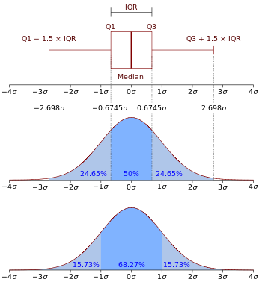
Normal Distribution

Slide 20
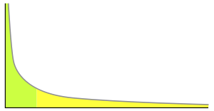
Power Law Distribution

Slide 22
Go To Gapminder
Try to use visualization to understand several key variables
THINK what types of relationships could be important
Add additional dimensions

Slide 23
Tools for Visualization
R (GGPLOT)
Tableau
D3

Slide 24
R-GGPLOT2
Based on the Grammar of Graphics, proposed by Leland Wilkinson. The grammar is based on of composition of building blocks according to certain rules. Statistical graphics are viewed as layers, each consisting of 4 elements:
Data
Mapping between variables and aesthetics (e.g. color, shape, scale)
Geometric Objects (e.g. points, lines, polygons)
Statistical Transformation (e.g. smoothing, binning in a histogram)

Slide 25
Rstudio GGPLOT Tutorial
http://blog.echen.me/2012/01/17/quick-introduction-to-ggplot2/

Slide 26
D3
D3.js is a JavaScript library for manipulating documents based on data. D3 helps you bring data to life using HTML, SVG and CSS. D3’s emphasis on web standards gives you the full capabilities of modern browsers without tying yourself to a proprietary framework, combining powerful visualization components and a data-driven approach to DOM manipulation.

Slide 27
D3
Publishing data visualizations online
Can be interactive
Open source packages continuously being enriched

Slide 28
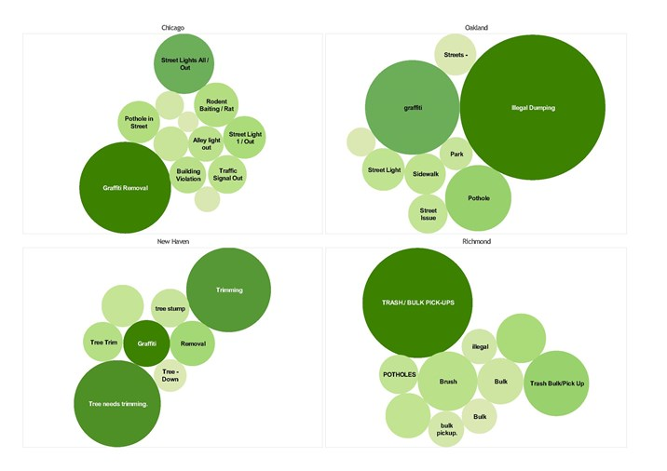
Visualization – See Predict Fix

Slide 29
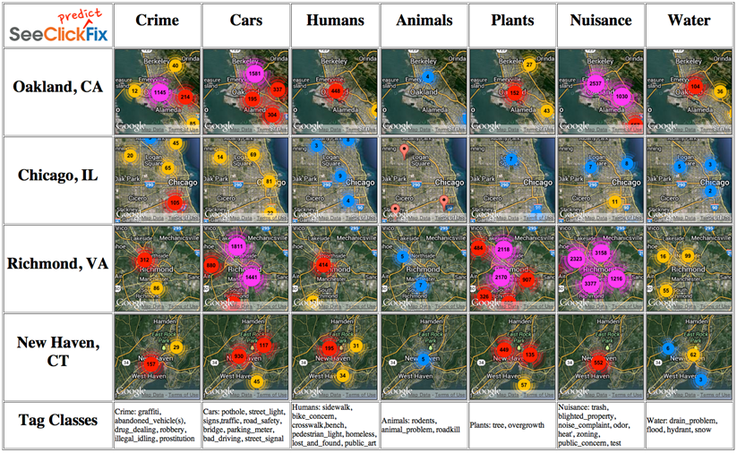
Visualization – See Predict Fix

Slide 30
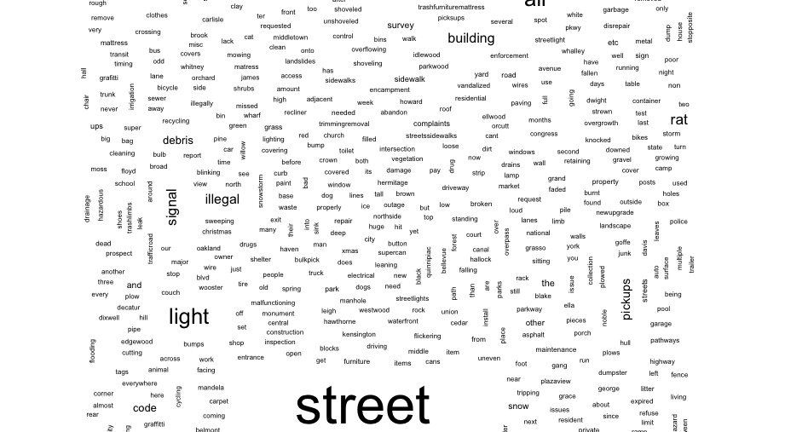
See Click Fix

Slide 31
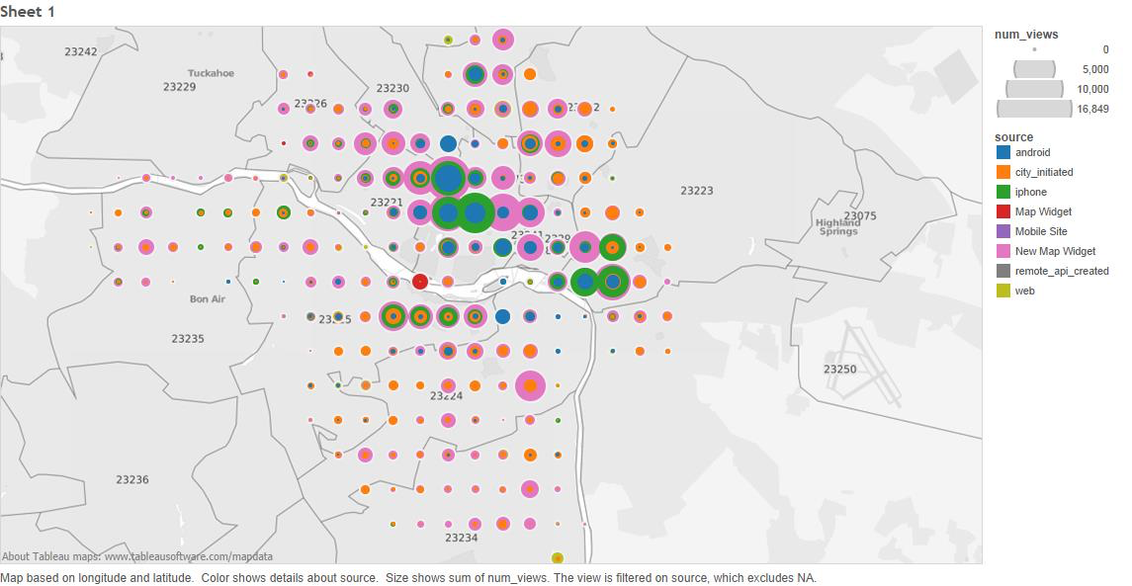

Kaggle Winner – See Predict Fix
Anqi Wu, Business Analytics 2014

Slide 32
Text Mining
Text data must be processed to gain understanding
A bag of words model, text (such as a sentence or a document) is represented as an unordered collection of words, disregarding grammar and even word order.
This is what we did in Hadoop with the Shakespeare word count

Slide 33
Text Mining
In linguistics, a corpus (plural corpora) or text corpus is a large and structured set of texts (nowadays usually electronically stored and processed). They are used to do statistical analysis and hypothesis testing, checking occurrences or validating linguistic rules within a specific language territory.

Slide 34
Text Mining
Preprocessing of text data:
Change all to lower case
Remove all numbers
Combine word stems (dumped vs dump)

Slide 35
Text Mining
In the fields of computational linguistics and probability, an n-gram is a contiguous sequence of n items from a given sequence of text or speech. The items can be phonemes, syllables, letters, words or base pairs according to the application. The n-grams typically are collected from a text or speech corpus.

Slide 36
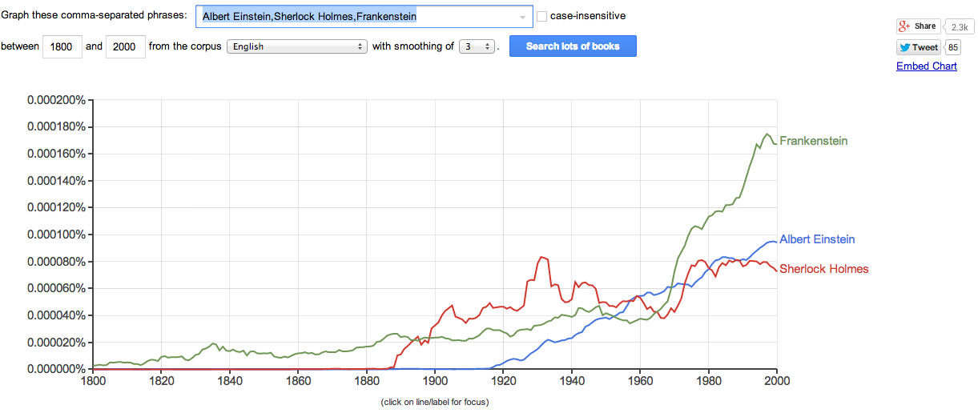
Google N-Gram Viewer

Slide 37
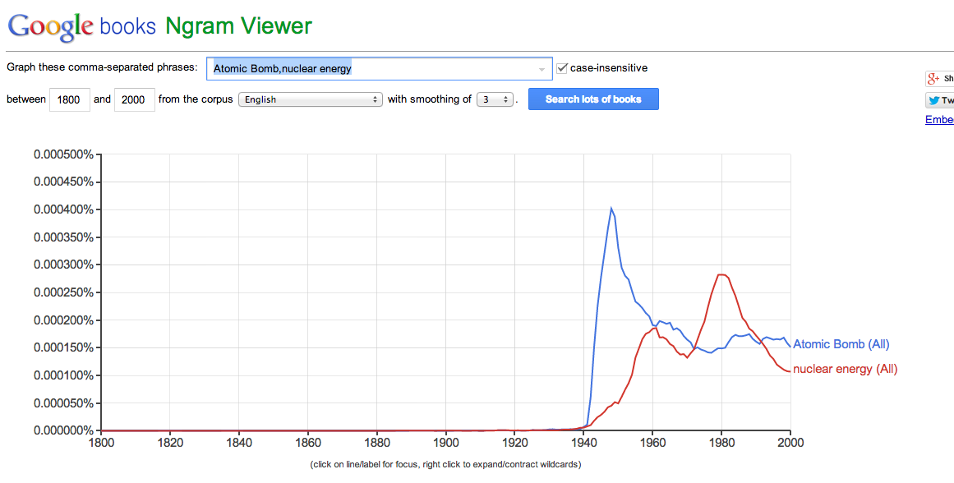
Google N-Gram Viewer

Slide 38
How Might We Assign City labels based on Longitude/Latitude?

Slide 39
Longitude and Latitude
Apply cluster analysis with 4 clusters
Aggregate the average longitude and latitude for each cluster
View on map or lookup via online tool (manually)

Slide 40
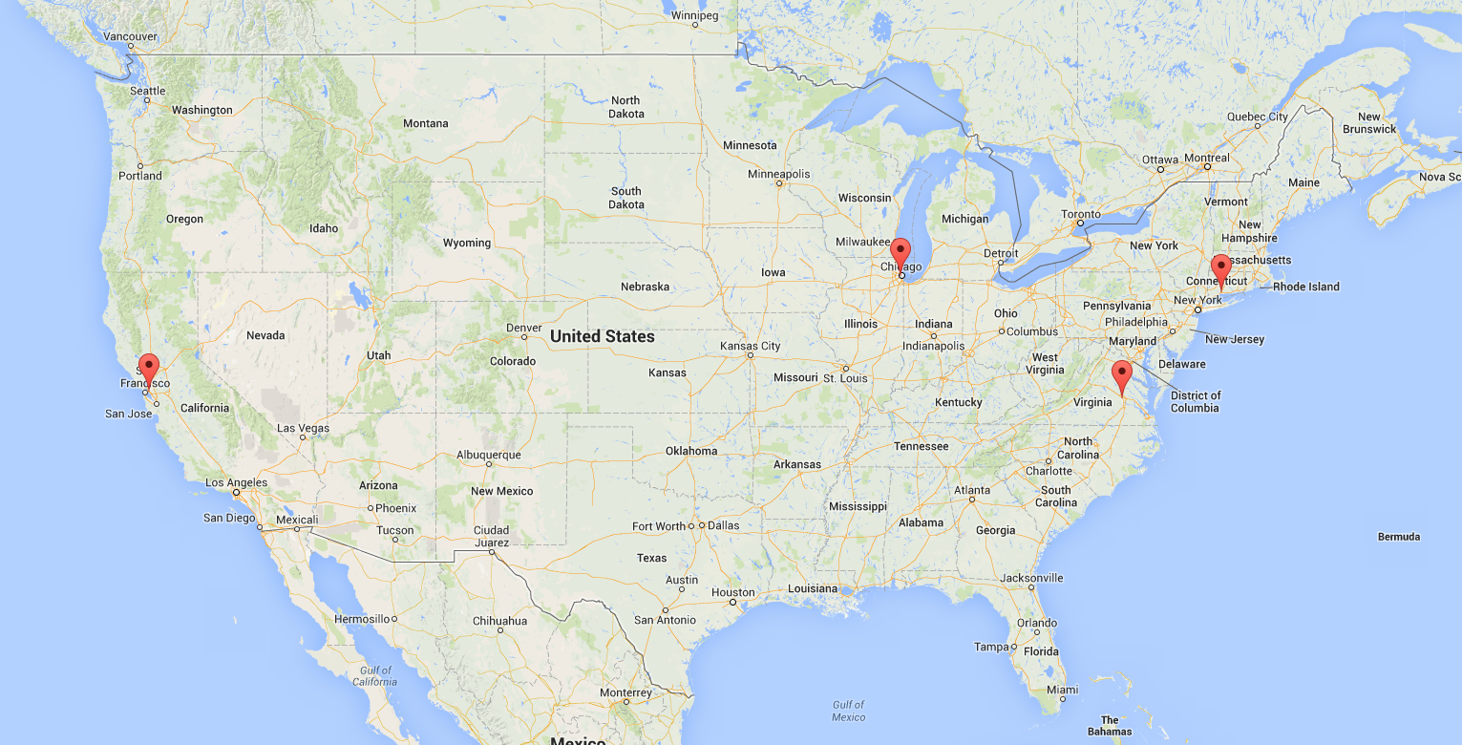
Graph – D3 and Map

